Slide 1
An Infographic of How The US Capitol Incident, and its Participants are Described in The Media
Muhammad Shahid Saleem

Slide 2
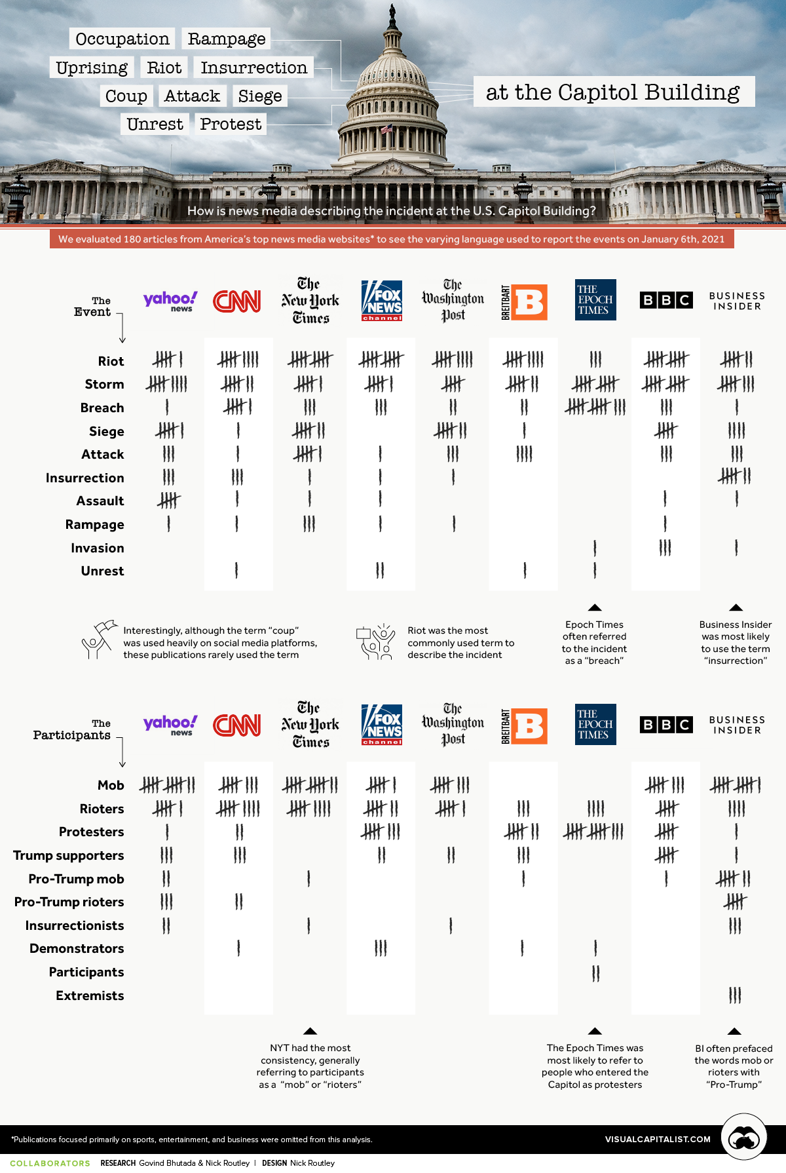
The Infographic: https://www.visualcapitalist.com/how-news-media-is-describing-the-incident-at-the-u-s-capitol/

Slide 3
Infographic Explanation
The chart indicates the frequency of various words used by top 9 news media to describe the incident and its participants.
The event itself is described as the ‘Riot’, ‘Storm’, or ‘Breach’ by every news media whereas The Epoch Times least used the word ‘Riot’ while it is among the top 3 users of the word ‘Storm’ and heaviest user of the word ‘Breach’.
The Epoch Times, BBC, and Business Insider were the only ones to ever describe the event as ‘Invasion’. All News outlets used the word ‘Rampage’ at least once except Business Insider, The Epoch Times, and Breitbart News.
The Epoch Times was almost laser focused on the usage of ‘Riot’, ‘Storm’, and ‘Breach’ whereas the Business Insider, BBC, CNN, and Yahoo News covered most of the spectrum of the 10 words used to describe this event.
As for the description of the participants of the event, all the media outlets (in this study) called them ‘Mob’ except Breitbart News and The Epoch Times. All the news media outlets consistently called them the ‘Rioters’ without any exception.
As for the coverage of the words used to describe the participants, Business Insider, CNN, and Yahoo News covered most of the word spectrum (in this study). Nobody called the participants ‘Extremist’ except the Business Insider, and ‘Participants’ except The Epoch Times. The New York Times remained heavily focused on the usage of words ‘Mob’, and ‘Rioters’

Slide 4
End

